Slide 1
Embedding Triangulated Terrain Models
Lee Glendenning

Slide 2
Motivation
Terrain visualization
Compress 2.5D to 2D with accurate distortion
Accuracy depends on weighting scheme
Notes:
The benefit of computing a Tutte embedding is that it allows a 2.5D or 3D model to be flattened and visualized in 2D with appropriate distortion. For example, viewing the map of Earth on a glove yields very different visual results to viewing Earth mapped to a rectangle as we often do. Countries near the North and South poles become distorted incorrectly.
A Tutte embedding of a 2.5D model, in some cases, could lead to reduced storage space since the z coordinates do not need to be stored and the information is accurately compressed.

Slide 3
Introduction
Tutte embedding (barycentric embedding)
Outer face convex
Interior vertices at average location of neighbours (barycenter)
Vertex position determined by solution to system of linear equations
Tutte’s spring theorem (1963)
Unique solution always planar
Every face of the planar embedding is convex
Notes:
A Tutte embedding or barycentric embedding of a connected planar graph is a crossing-free straight-line embedding with the properties that the outer face is a convex polygon and that each interior vertex is at the average (or barycenter) of its neighbors' positions We will see different weighting schemes that differ from this average position
If the outer polygon is fixed, this condition on the interior vertices determines their position uniquely as the solution to a system of linear equations
Tutte's spring theorem, proven by W. T. Tutte (1963), states that this unique solution is always crossing-free, and more strongly that every face of the resulting planar embedding is convex [1]. It is called the spring theorem because such an embedding can be found as the equilibrium position for a system of springs representing the edges of the graph

Slide 4
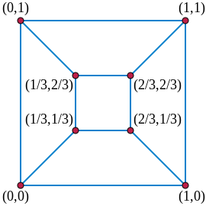
Example

Slide 5
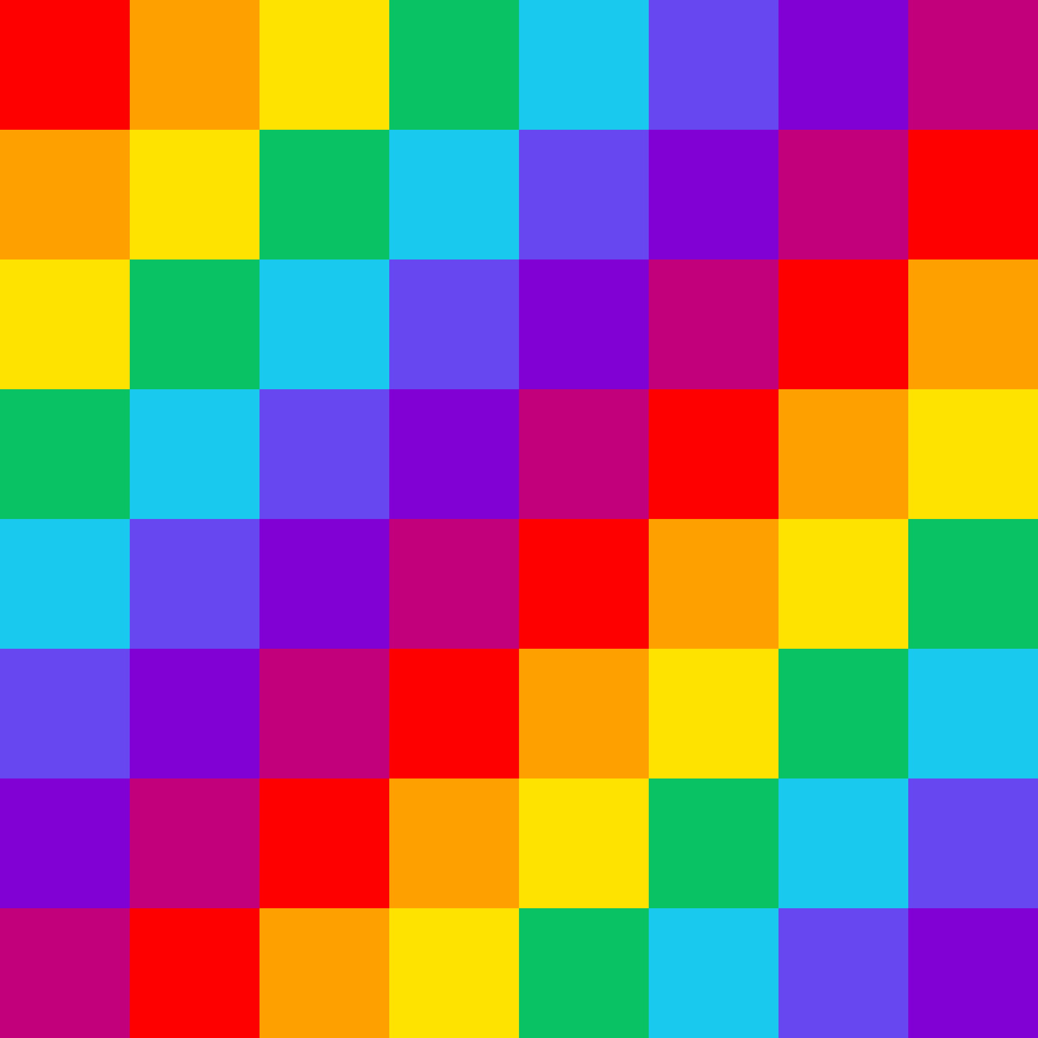
Implementation
Input: triangulated mesh with convex boundary (.obj)
Libraries: OpenMesh, Eigen
Output: flattened mesh with parameterization saved as texture coordinates
Visualize results using MeshLab by texturing mesh

Slide 6
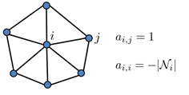
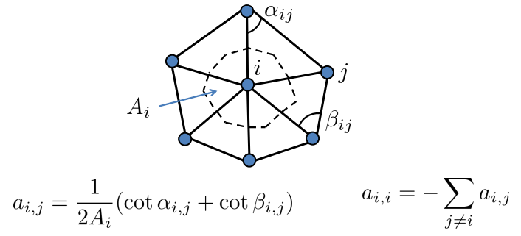
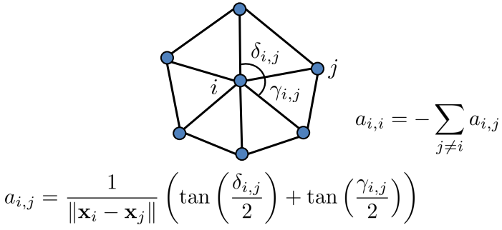
Weighting Schemes
Uniform Laplacian:
Laplace-Beltrami:
Mean-value:
Notes:
Uniform-Laplacian:
applies uniform weights to neighbouring vertices. Simple to build but does not take geometry into account
Laplace-beltrami:
This scheme takes the geometry of the mesh into account. That is, it captures triangle angles and edge lengths, and thus will adapt the parameterization according to the geometry of the shape
Mean-value:
based on the Mean Value Theorem
generalization of barycentric weights

Slide 7
System of Equations
For boundary vertices, a_{i,i} = 0
If a_{i,j} not an edge, a_{i,j} = 0
u, v vectors: hold x and y coordinate value of each vertex in mesh
Solve 2 linear systems: au = x, av = y
X and y become the parameterization

Slide 8

Results

Slide 9
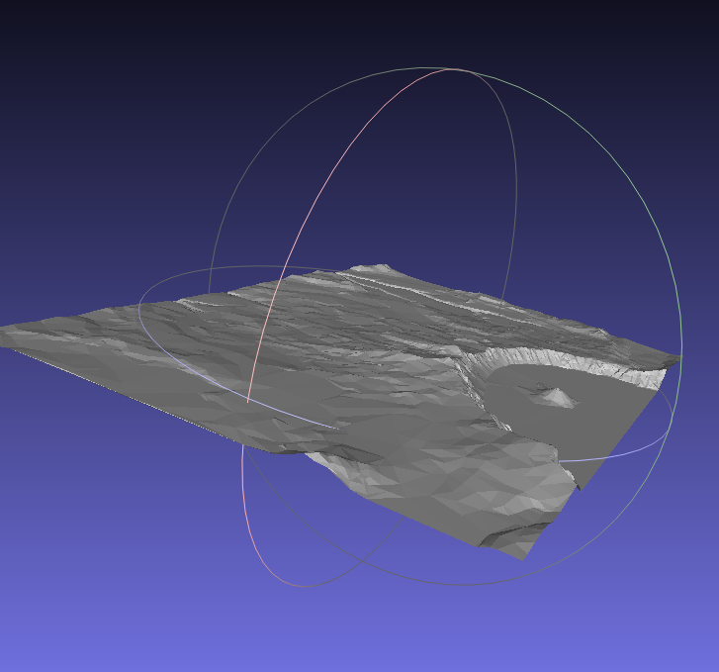
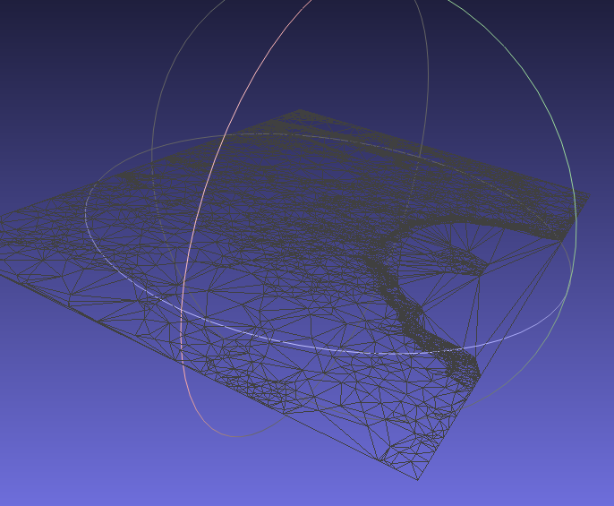
Results

Slide 10
Conclusion
Embedding found in polynomial time by solving the system of equations
Set up sparse matrix O(n)
Solve linear system O(n³) in worst case but sparse matrix => better
LDL decomposition
Linear space – store mesh once
Laplace-Beltrami yields best results (theoretically)
Captures triangle angles and edge lengths in parameterization
Notes:
This scheme takes the geometry of the mesh into account. That is, it captures triangle angles and edge lengths, and thus will adapt the parameterization according to the geometry of the shape

Slide 11
Thank you
Questions?

